Slide 1
Aggregate Functions

Slide 2
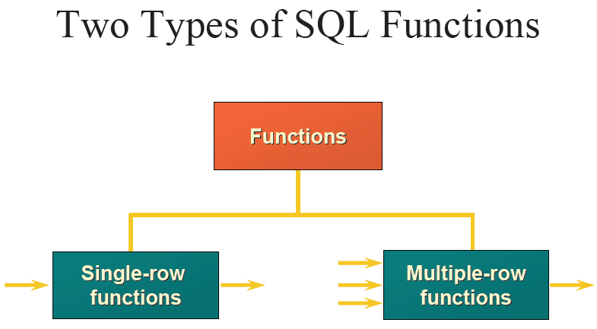

Slide 3
Group functions differ from single-row functions in how they are evaluated.
Single-row functions are evaluated once for each row retrieved.
Group functions are evaluated on groups of one or more rows at a time.
Group functions are also called aggregate functions and return a value based on a number of inputs.
The exact number of inputs is not determined until the query is executed and all rows are fetched.

Slide 4
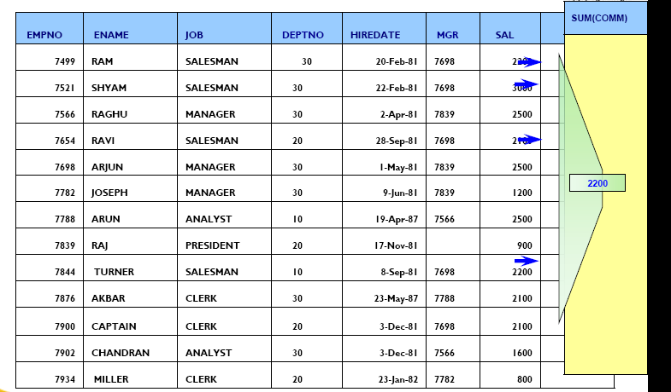

Slide 5
AVG
SUM
MAX
MIN
COUNT
COVAR_POP
COVAR_SAMP
CUME_DIST
DENSE_RANK
FIRST
LAST
STDDEV
STDDEV_POP
STDDEV_SAMP
CORR
PERCENTILE_CONT
PERCENTILE_DISC
PERCENT_RANK
RANK
REGR_ (linear regression) functions
VAR_POP
VAR_SAMP
VARIANCE
GROUP_ID
GROUPING
GROUPING_ID
CUBE
ROLLUP

Slide 6
AVG
The following example calculates the average salary of all employees in the employees table:
SELECT AVG(sal) "Average" FROM emp;
Average
--------
2073.21429
AVG returns Average value of expr. You can use it as an aggregate or analytic function.

Slide 7
MAX
The following example determines the highest salary in the hr.employees table:
SELECT MAX(sal) "Maximum" FROM emp;
Maximum
----------
5000
MAX returns Maximum value of expr. You can use it as an aggregate or analytic function.

Slide 8
MIN
MIN returns minimum value of expr. You can use it as an aggregate or analytic function.
SELECT MIN(hiredate) "Earliest" FROM emp;
Earliest
---------
17-DEC-80

Slide 9
COUNT
COUNT returns the number of rows in the query. You can use it as an aggregate or analytic function.
If you specify expr, COUNT returns the number of rows where expr is not null.
You can count either all rows, or only distinct values of expr.

Slide 10
If you specify the asterisk (*), this function returns all rows, including duplicates and nulls. COUNT never returns null.
The following examples use COUNT as an aggregate function:
SELECT COUNT(*) "Total" FROM emp;
Total
----------
14

Slide 11
SELECT COUNT(*) "Allstars" FROM emp
WHERE comm > 0;
Allstars
---------
3

Slide 12
All Vs. Distinct
Most of the group functions can be applied either to ALL values or to only the DISTINCT values for the specified expression.
When ALL is specified, all non-NULL values are applied to the group function. When DISTINCT is specified, only one of each non-NULL values is applied to the function.
DISTINCT causes an aggregate function to consider only distinct values of the argument expression.
ALL causes an aggregate function to consider all values, including all duplicates.

Slide 13
SELECT COUNT(all comm) "Count" FROM emp;
Count
----------
4
SELECT COUNT(DISTINCT mgr) "Managers" FROM emp;
Managers
----------
6

Slide 14
For example, the DISTINCT average of 1, 1, 1, and 3 is 2. The ALL average is 1.5. If you specify neither, the default is ALL.
Select count(sal) from emp;
Select count(distinct sal) from emp;
Select count(comm) from emp;
Select sum(all sal) total from emp;
Select sum(distinct sal) total from emp;
Select sum(comm) comm from emp;
Select sum(all comm) comm from emp;
Select avg(comm) comm from emp;
Select avg(all comm) comm from emp;

Slide 15
Aggregate functions return a single result row based on groups of rows, rather than on single rows.
Aggregate functions can appear in SELECT lists and in ORDER BY and HAVING clauses but can not appear in WHERE clause.
Some Group functions do not process NULL values and do not return a NULL value, even when NULLS are the only values evaluated.
A COUNT of NULL values will result in 0.

Slide 16
They are commonly used with the GROUP BY clause in a SELECT statement, where Oracle divides the rows of a queried table or view into groups.
Oracle applies the aggregate functions to each group of rows and returns a single result row for each group.

Slide 17
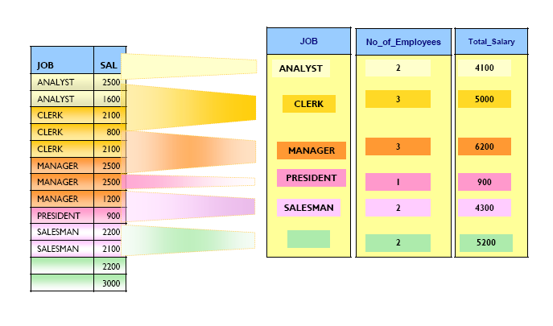
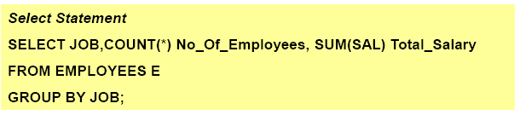

Slide 19
If you omit the GROUP BY clause, Oracle applies aggregate functions in the select list to all the rows in the queried table or view.
Aggregate functions used in the HAVING clause to eliminate groups from the output based on the results of the aggregate functions
In a query containing a GROUP BY clause, the elements of the select list can be aggregate functions, GROUP BY expressions, constants, or expressions involving one of these.

Slide 20
GROUP BY Examples
To return the minimum and maximum salaries for each department in the emp table, issue the following statement:
SELECT deptno, MIN(sal), MAX (sal)FROM emp GROUP BY deptno;

Slide 21
To return the minimum and maximum salaries for the clerks in each department, issue the following statement:
SELECT deptno, MIN(sal), MAX (sal)FROM emp WHERE job = 'CLERK' GROUP BY deptno;

Slide 22
You can use multiple columns in group by clause if required
Grouping Will be done based on multiple Column values
SELECT deptno, MIN(sal), MAX (sal)FROM emp GROUP BY deptno, Job;

Slide 23
Queries to write
To return the total number of employees working under each manager.
To list total number of employees working under each job category.
To list total number of employees working under each department.
Maximum Salary for each job in each department,

Slide 24
SELECT deptno, MIN(sal),
MAX(sal) FROM emp
WHERE MIN(sal) > 2000
GROUP BY deptno;
HAVING
Having Clause Filters Group to participate in the result set.

Slide 25
HAVING Example
To return the minimum and maximum salaries for the employees in each department whose lowest salary is below $5,000, issue the next statement:
SELECT department_id, MIN(salary), MAX (salary)
FROM employees
GROUP BY department_id
HAVING MIN(salary) < 5000;

Slide 26
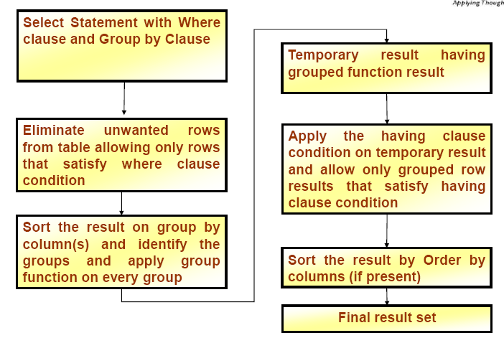

Slide 27
All aggregate functions except COUNT(*) and GROUPING ignore nulls.
You can use the NVL function in the argument to an aggregate function to substitute a value for a null.
COUNT never returns null, but returns either a number or zero.
For all the remaining aggregate functions, if the data set contains no rows, or contains only rows with nulls as arguments to the aggregate function, then the function returns null.

Slide 28
Select department_id, count(last_name) from employees;
Select max(count(distinct job)) from emp group by deptno;
Select max(sal), deptno from emp group by deptno;
Select max(sal), deptno from emp group by job;
Select deptno, job, max(sal) from emp group by deptno,job;

Slide 29
Select deptno,job, max(sal) from emp group by deptno;
Select deptno,max(sal),count(*) from emp ;
Select deptno,max(sal),count(*) from emp group by deptno;
Select count(distinct deparment_id) from employees;
Select avg(nvl(commission_pct,0)) from employees;

Slide 30
select job_id, sum(salary) payroll from employees
where job_id not like '%cler%' group by job_id
having sum(salary) > 13000 order by sum(salary);

Slide 31
Nesting Functions
Functions can be nested so that the output from one function is used as input to another.
Functions are evaluated innermost to outmost and left to right.
Nested functions can include single-row functions nested within group functions, or group functions nested within either single row functions or other group functions.

Slide 32
Nested Functions Example
SELECT AVG(MAX(salary)) FROM employees GROUP BY department_id;

Slide 33
Select deptno, greatest (count (distinct job), count (distinct mgr)), count (distinct job) jobs, count(distinct mgr) mgrs
from emp group by deptno;

Slide 34

THANKS

